Slide 1
The Software Industry in Japan and
Empirical Software Engineering
NASSCOM Quality Summit
Koji Torii
Executive Director, Professor
EASE Project, Nara Institute of Science and Technology

Slide 2
Today’s agenda
Japan’s situation with regard to software industries, i.e.,
  Examples of recent aspects/accidents/topics in Japan
    i.e., crisis, measurement-base, embedded
Japan SEC (Software Engineering Center) under METI
Empirical Software Engineering
EASE Project under MEXT
  The introduction of empirical software engineering
EPM (Empirical Project Monitor) in EASE
  Automatic data collection system
  Open Source System
Data Analysis with EPM
Summary

Slide 3
The crisis of software development
High-reliability and high-productivity of software development is desired.
The volume of development per developer keeps increasing.
  The program size of the third generation mobile phone is about five million lines. This equals that of the third generation of online banking systems introduced in 1985.
  The number of software development employees has only increased by a total of 6% over the 5 years from 1998 to 2003, although sales within the information service industry have increased by 45%.
Software defects cause a large social and economic loss.
  Accidents include mobile-phones, trains, airplanes, banking systems
  In February 2005, a software problem in the engine control of eight car models was discovered leading to their recall.
  In March 2005 a software glitch in the Shinkansen’s (Japanese bullet train) ATC affected 100 trains.

Slide 4


Making software reliable and improving productivity by using measurement data
In the car industry over one million improvements per year are made based on measurement data obtained from development sites, and a saving of $1 billion US a year is achieved.
Point of sales systems
  Systems that record sales information about commodities sold in supermarkets and local convenience stores then use the result to control stock and for marketing purposes.
  The sales trends of two or more stores can be compared, and the data can be linked to other data including weather data, which allows overlaps and tendencies to be understood.

Slide 5
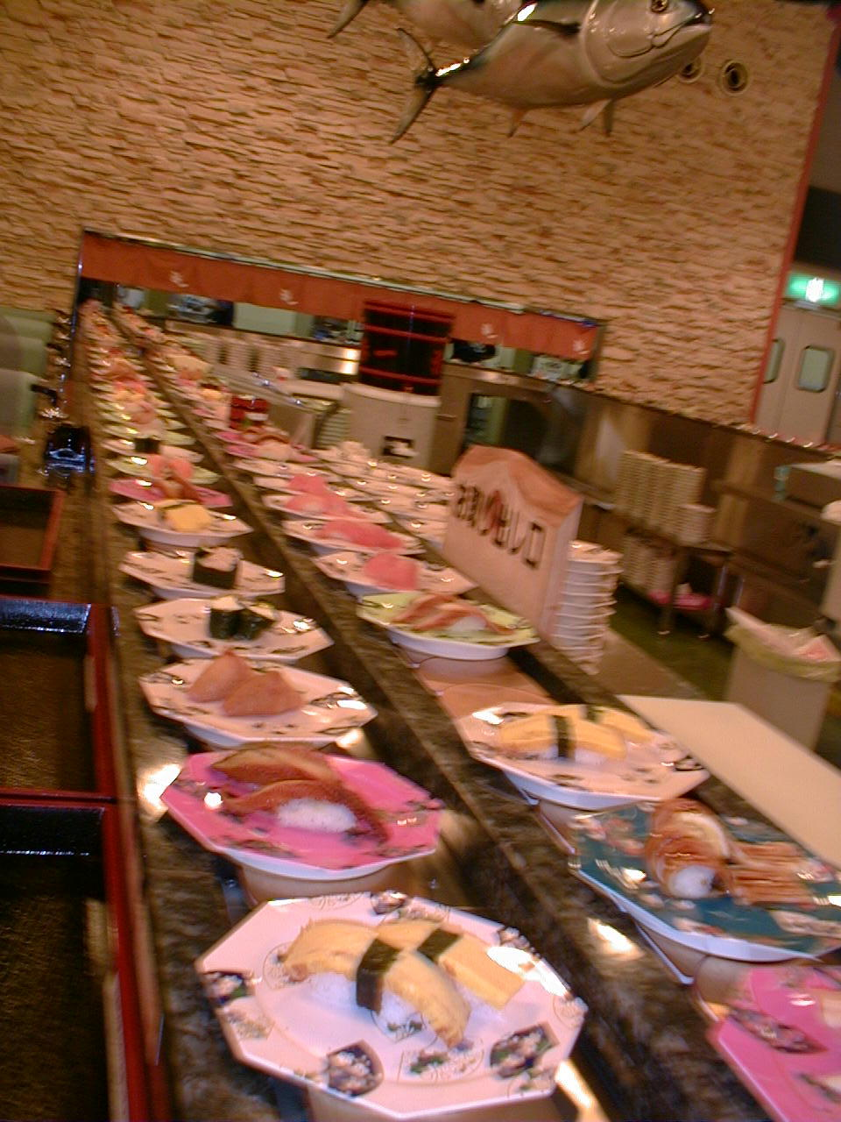
Smart counting ~ sushi-conveyer-belt case
Traditionally
◆Diners pay for food based on the
number of plates remaining.
◆Waiters counted the number of
plates (price per plate differs
according to colour;
e.g.: Red = $1, Green = $2,
Blue = $3).
Problems with this traditional counting
method:
◆Time consuming
◆Prone to mistakes
Notes:
This is sushi-go-round restaurant. Diners will serve themselves by choosing plates of sushi going round and round on the conveyer belt.
Prices vary, broken down by plate’s colors, such as green plate for $1 and pink plate for $2 and so on.
As plates pile up, counting them becomes a fuss, and people make mistakes.
from これは、回転寿司レストランの風景です。ベルトコンベアでサーブされるすしから好きな皿を選んで食べます。
緑の皿のすしは１皿1ドル、ピンクの皿は2ドル、というように９つの色がありそれぞれ
たくさんの種類を食べるので計算が面倒で、間違いも起きやすいです。

Slide 6
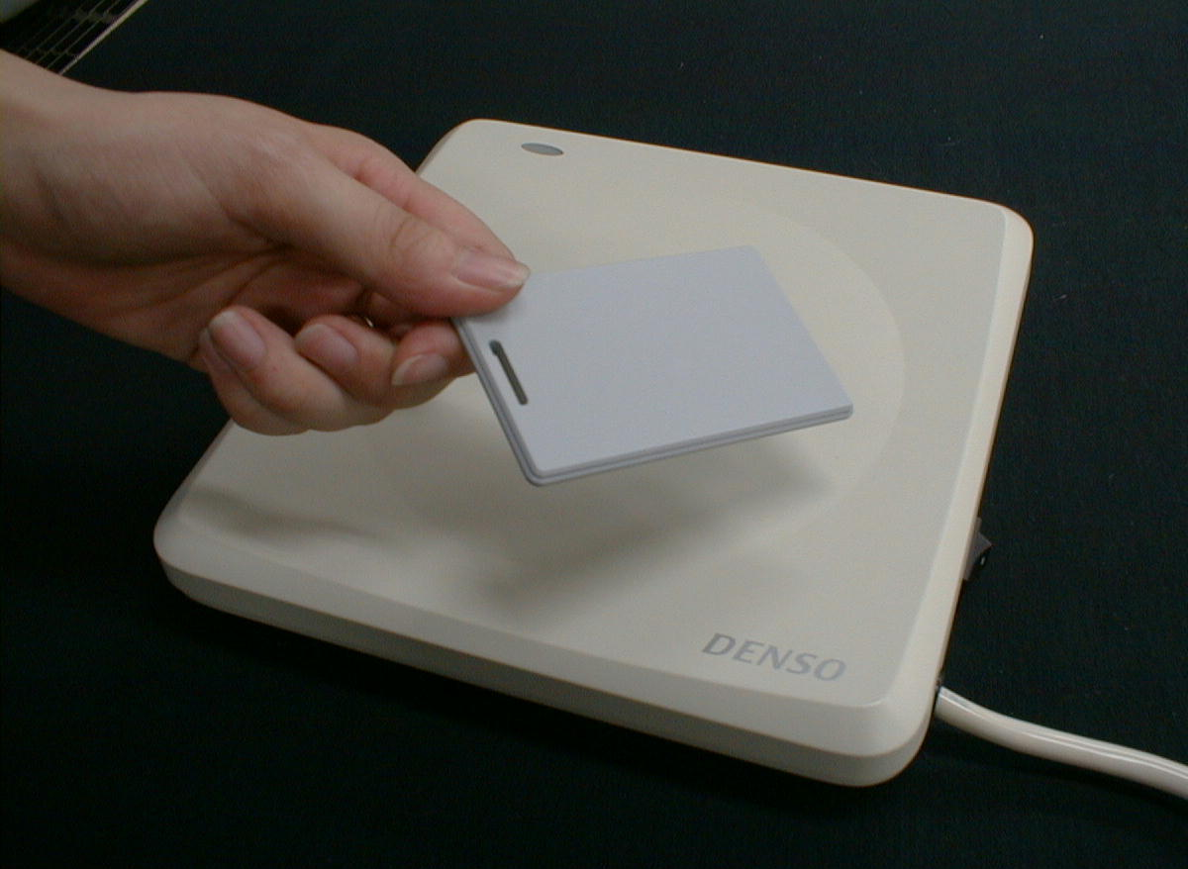
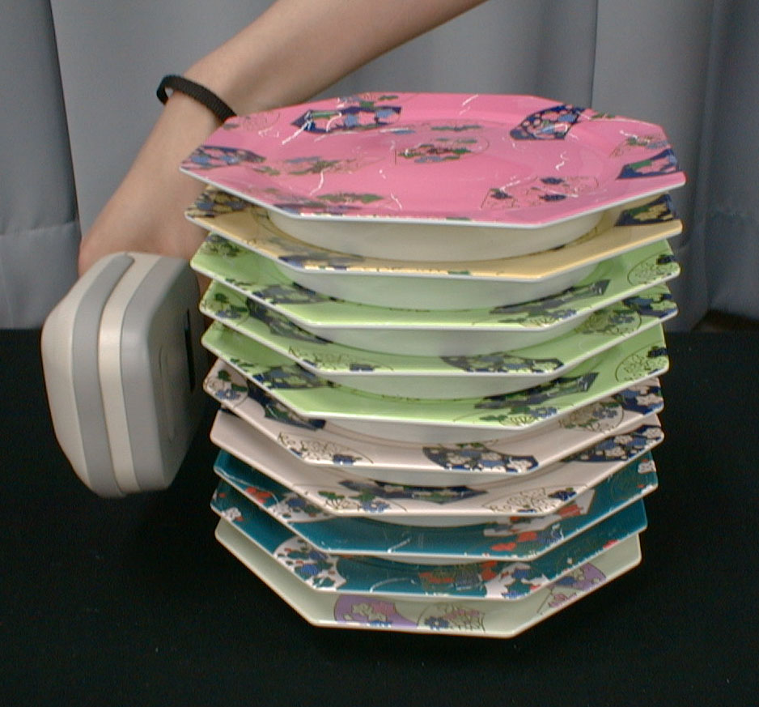
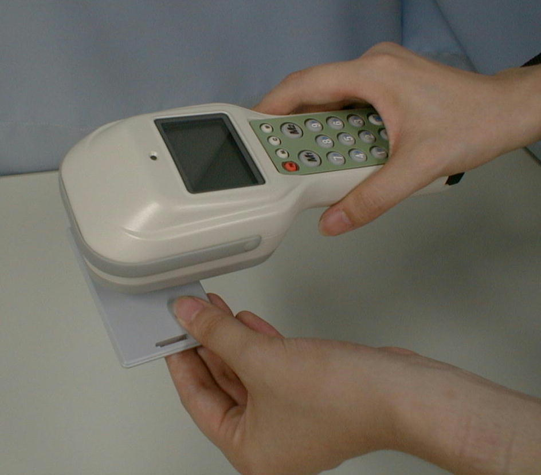
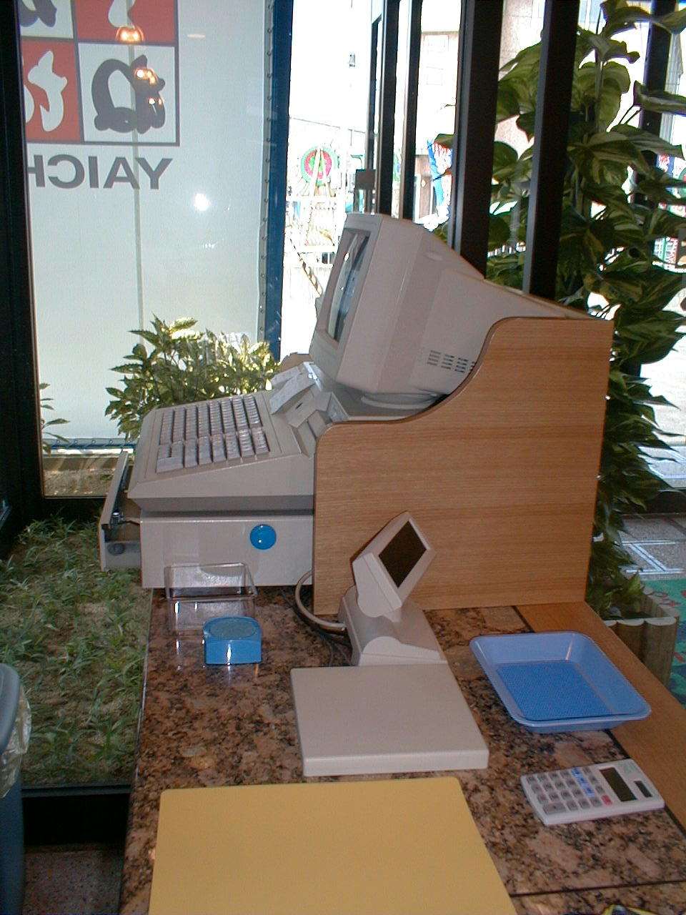
Smart counting ~ sushi-conveyer-belt case (cont.)
Breakthrough: RFID in Use
RFID tags embedded in sushi plates
①Automatic Count
(Time efficient; Accurate count)
②Automatic reading at the checkout counter
(Time efficient; Accurate count)
Sushi plates with
RFID tags
Transmitting
information from
reader onto the card
Automatic
payoff at the
checkout
Notes:
This is where electronic tags come in to rescue us.
They are inserted into plates to make the counting process easier.
On the left picture, the reading tags on the plates.
On the right picture, transmitting the read data to checkout to make payment.
そこで皿に電子タグをはりつけ、簡単に計算できるようにしました。
左側の写真は皿に貼り付けられたタグを読みとっているところ。
右側は、読みとったデータをレジに持っていって支払いをするところです。

Slide 7
Profile of the Embedded Software Industry in Japan
The Embedded Software Industry
  Engineers: 150,000.
  Development size: $20 billion US.
    Output of embedded systems (dynamic statistics):
    $500 billion US.
  Output: about 10 billion lines/year
    One engineer develops 6,000 lines/year on average.
Comparison Figures from the Information Service Industry
  Employees: 510,000
  Sales: $140 billion US
Source: Report on Embedded Software Industries (The Ministry of Economy, Trade and Industries, 2004)

Slide 8
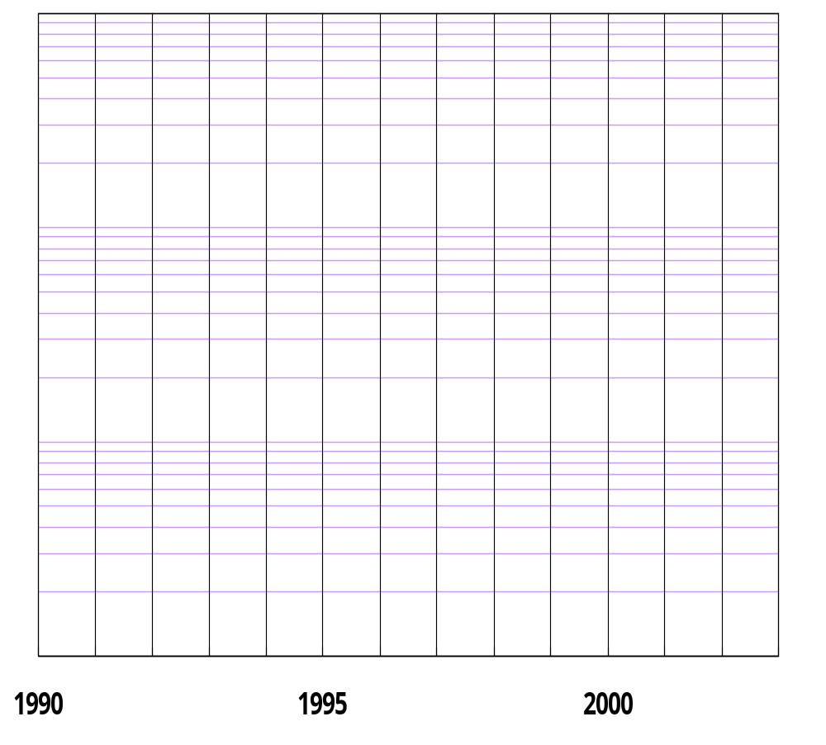


The continuously expanding scale of the embedded software industries
Object Size
Examples（SLOC*）
Car Navigation System with PDA
  3 million
LCD/Plasma TVs
  0.6 million
DVD recorder with built-in HDD
  1 million
100MB
ITS enabled
i-mode enabled
DVD enabled
data-storage broadcasting
voice guidance
CD-ROM
VICS enabled
3/4G enabled
10M
Java enabled
Car Nav.
i-mode enabled
packet communication enabled
1M
TVs
digital cell phone
Internet TV
100K
Hi-Vision TV
Cell Phones
  * SLOC: Source Lines of Code
Source: Nikkei Electronics, 2000 9-11(no.778)

Slide 9
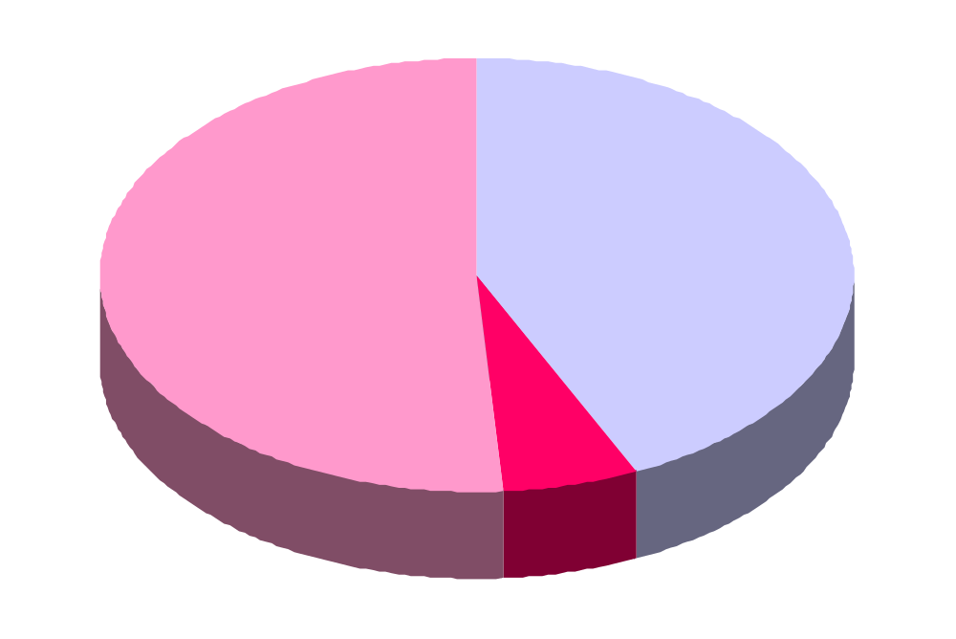

The realities of measurement of customized software development
Cost estimation
by …
Measure- ment data
５１％
Experience and analogy
４３％
Japan Information Service Industry Association (JISA)
"Questionnaire survey related to customized software development in information service industry" 2004.

Slide 10
Japan SEC
(Japan Software Engineering Center)

Slide 11
The Japan Software Engineering Center (SEC)
Opened in October 2004 supported by the Ministry of Economy, Trade and Industry (METI).
Budget of 2004: $14.8 million US
The SEC mission
  To provide common understanding of
    Data-oriented quantitative approaches
      Collect real project data (quantitative and qualitative)
      Create benchmarks
    Best practices
      Provide guidelines about roles and recommended activities.

Slide 12
The SEC activities and approaches
Conduct in-depth practical studies to solve the issues of today’s software industry.
  Software Process Improvement methods for the Japanese Industry
  Software measurement standards
    Gather data from various software development projects underway.
    Analyze these quantitative data.
    Promote the use of measurement standards.
  Demonstration of the methods and tools in advanced software development projects

Slide 13
The SEC projects
Software engineering for enterprise systems
  Improve quality and productivity
Software engineering for embedded technology
  Strengthen development capability,
  Nurture skilled engineers,
Advanced software development
  Building best practices

Slide 14
Empirical Software Engineering

Slide 15
Why empirical software engineering? （Basili）
Understanding a discipline involves building models,
e.g., application domain, problem solving processes
Checking our understanding is correct,
e.g., testing our models, experimenting in the real world
Analyzing the results
  e.g. learning, the encapsulation of knowledge
This is the empirical paradigm that has been used in many fields,
e.g., physics, medicine, manufacturing
Like other disciplines, software engineering requires an empirical paradigm

Slide 16
Why empirical software engineering? (Basili)
Empirical software engineering requires
  the scientific use of quantitative and qualitative data
  about the software product, software development process and software management
It requires real world laboratories
  Research needs laboratories to observe and manipulate the variables
  Development needs models to understand how to build systems better
Research and Development have a symbiotic relationship

Slide 17
Observations, laws and theories (Rombach)
Empirical observations
  Facts from individual empirical studies.
  We can characterize phenomena based on them.
Laws
  Repeatable observations.
  We can understand context enough to make prediction about future observations.
  We can predict phenomena by them. (what)
Theories
  Cause-effect relationships.
  We can explain phenomena by them. (why)

Slide 18

Journal by Kluwer
Empirical Software Engineering
Scope
  Cost estimation techniques
  Analysis of the effects of design methods and characteristics
  Evaluation of testing methodologies
  Development of predictive models of defect rates and reliability from real data
  Infrastructure issues, such as
  measurement theory, experimental
  design, qualitative modeling and
  analysis approaches.
  …

Slide 19

International Symposium on Empirical Software Engineering
ISESE2002 @ Nara, Japan
ISESE2003 @ Roma, Italy
ISESE2004 @ California, USA
ISESE2005 @ Noosa Heads, AU
・・・

Slide 20
ISERN
International Software Engineering Research Network
ISERN is a community that believes software engineering research needs to be performed in an experimental context.
ISERN was established in 1993 by researchers of software engineering from 12 countries, including USA, Germany, Australia, Italy, Finland and Japan.
ISERN provides several means of communication between members;
  Electronic Communication,
  Annual meetings, and
  Exchange of researchers.

Slide 21
The EASE Project

Slide 22

What is the EASE project?
Empirical Approach to Software Engineering
One of the leading projects of the Ministry of Education, Culture, Sports, Science and Technology (MEXT).
5 year project starting in 2003.
Budget: $2 million US / year.
Project leader: Koji Torii, NAIST
Sub-leader: Katsuro Inoue, Osaka University
Kenichi Matsumoto, NAIST
http://www.empirical.jp/English/

Slide 23
The purpose of the EASE project
Achievement of software development technology based on quantitative data
  Construction of a quantitative data collection system
    Result 1: Making of EPM open source
  Construction of a system that supports development based on analyzed data
    Result 2: EPM application experience
    Result 3: Coordinated cooperation with SEC
Spread and promotion of software development technology based on quantitative data to industry sites
    Result 4: Activation of the industrial world

Slide 24
Empirical activities in EASE
Data collection in real time, e.g.
  configuration management history
  issue tracking history
  e-mail communication history
Analysis with software tools, e.g.
  metrics measurement
  project categorization
  collaborative filtering
  software component retrieval
Feedback to stakeholders for improvement, e.g.
  observations and rules
  experiences and instances in previous projects
Data
Collection
Data
Analysis
Feedback

Slide 25
The EASE roadmap
Software
Development With
High Reliability and
Productivity
Social impact
Effectiveness
Data collection
Upstream
Product Data
Production Data
Project
Plan Data
Data analysis
Suggestions
Feedback
Data
Sharing
Communication
Data
Estimation
Alternatives
Exception Analysis
Industry Level Sharing
Related Cases
Quality Data
Characterization
Analysis
Results
Sharing Between Organizations
Downstream
Product Data
Collected data
Sharing Between Projects
Sharing Between Developers
2003/4
2004/4
2005/4
2006/4
2007/4
2008/3

Slide 26
EPM

Slide 27
EPM: the Empirical Project Monitor
An application supporting empirical software engineering
EPM automatically collects development data accumulated in development tools through everyday development activities
  Configuration management system: CVS
  Issue tracking systems: GNATS
  Mailing list managers: Mailman, Majordomo, FML

Slide 28


Architecture of the Empirical Project Monitor (EPM)
GQM
Code clone
detection
Component
search (SPARS)
Metrics
measurement
Logical Coupling
Collaborative
filtering
Product data archive (CVS format)
Process data archive (XML format)
Format
Translator
Format
Translator
Format
Translator
Format
Translator
Source Share GUI
Project x
Versioning
(CVS)
Mailing
(Mailman)
Issue tracking
(GNATS)
Other tool
data
Managers
Project y
Project z
Developers
. . .

Slide 29
Implementation of the Empirical Project Monitor (EPM)
Co-existing tools
Plug-in
Co-existing tools
Code clone
detection
Component
search
Metrics
measurement
Logical Coupling
Collaborative
filtering
Product data archive (CVS format)
Process data archive (XML format)
Format
Translator
Format
Translator
Format
Translator
Format
Translator
Core EPM
Source Share GUI
Project x
Versioning
(CVS)
Mailing
(Mailman)
Issue tracking
(GNATS)
Other tool
data
Managers
Project y
Project z
Developers
. . .

Slide 30
Automated data collection in EPM
Reduces the reporting burden on developers
  without additional work for developers
Reduces the project information delay
  data available in real time
Avoids mistakes and estimation errors
  uses real (quantitative) data

Slide 31
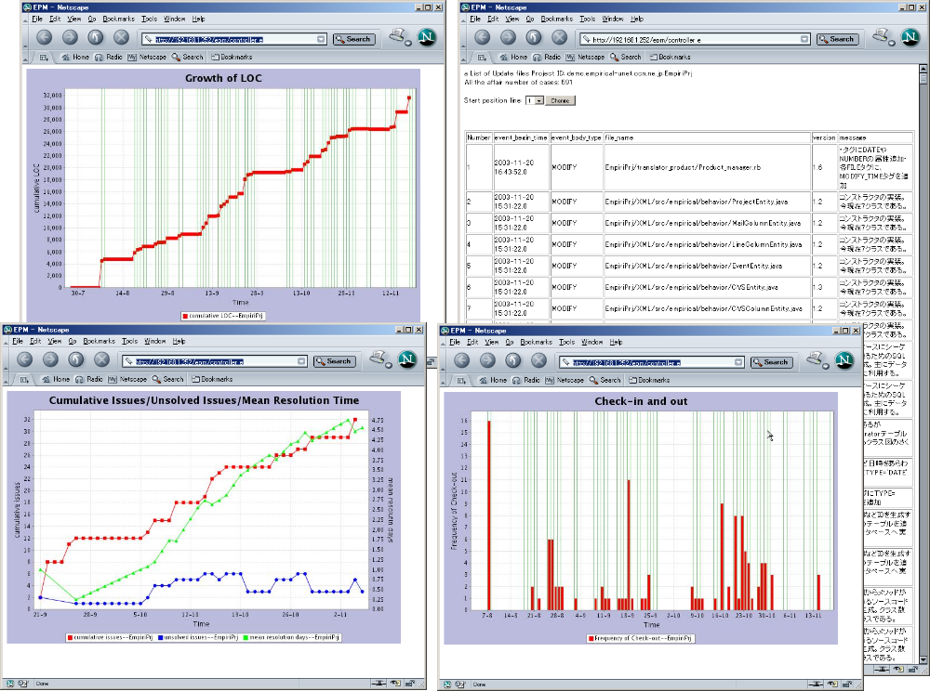
EPM’s GUI

Slide 32
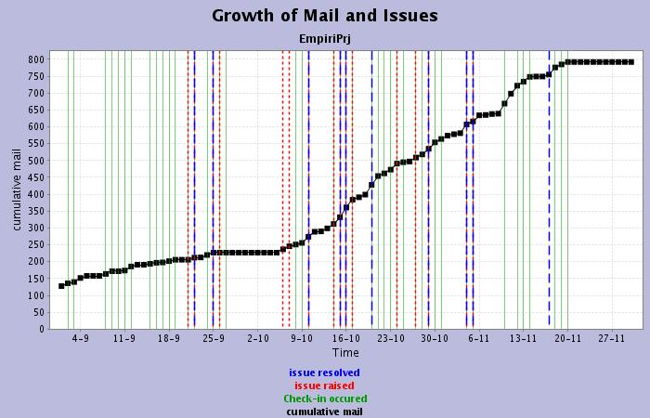
An example of output
EPM can put data collected by CVS, Mailman, and GNATS together into one graph.
Cumulative number of mails exchanged among developers
Time stamp of program code check-in to CVS
Time stamp of issue occurrence
Time stamp of issue fixing

Slide 33
Merits to introducing EPM
Easy monitoring of projects in cooperation with the existing development environment.
Easy accumulation of the knowledge and experience of projects.
Collection and sharing of uniform data for projects in real time.
Sharing and reuse of information enabled through empirical data.
Notes:
The following advantages will be provided to the software developers, managers, and users, leading to productivity and quality improvement.

Slide 34
Data Analysis with EPM

Slide 35
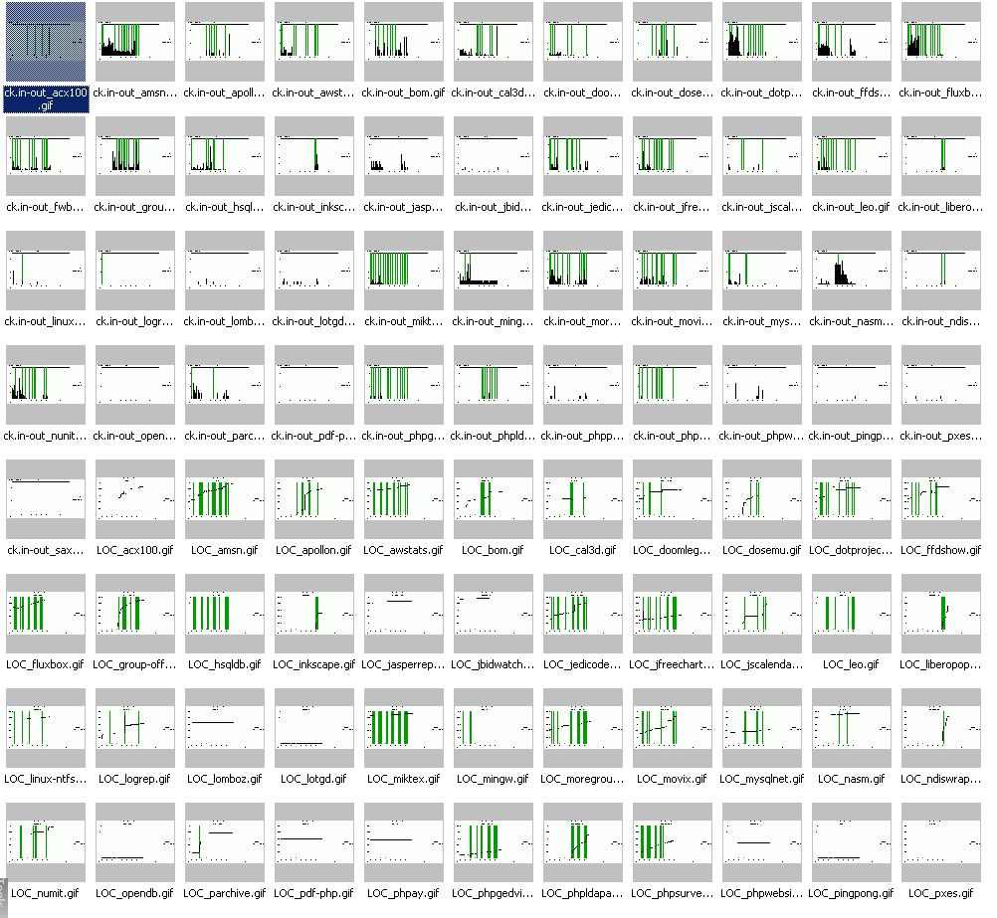
How can we use so much data?

Slide 36
Analysis technologies and models
Collection, analysis, and search engine of software products (SPARS: Software Product Archive, analysis, and Retrieval System)
Code clone analysis (CCfinder)
Collaborative filtering
Logical coupling
GQM (Goal/Question/Metric) model

Slide 37
Analysis targets
Collection, analysis, and search engine of software products (SPARS)
Code clone analysis
Collaborative filtering
Logical coupling
GQM(Goal/Question/Metric)Model
Estimation of requirements for re-design caused by connections in the
system structure
Manager support
The project delay risk detection model
Making similarity visible
The project management models for trouble evaluation
Class and utility evaluation of information related to use of methods
Estimate of effort to correct based on file scale, number of
accumulated defects, and defect type
Evaluation of clone distribution
Developer support
Evaluation of component ranking
Distinction of modules (file) with high defect rates
ID candidates for refactoring
Expert identification
Grasp of the situation Abnormal detection Forecast Advice

Slide 38
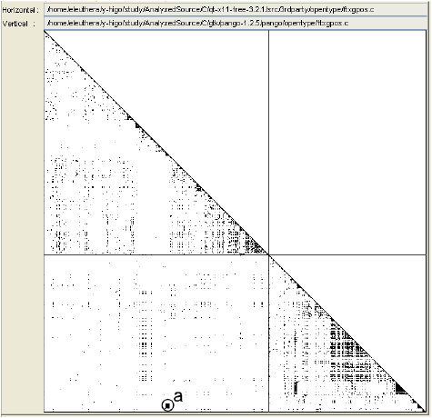
Analysis Technology (1-1)
Code Clone Detection
Code-Clone Analysis between Qt and GTK
Area “a” has high clone
density (because of font handler sharing)
Notes:
Qt
GTK

Slide 39
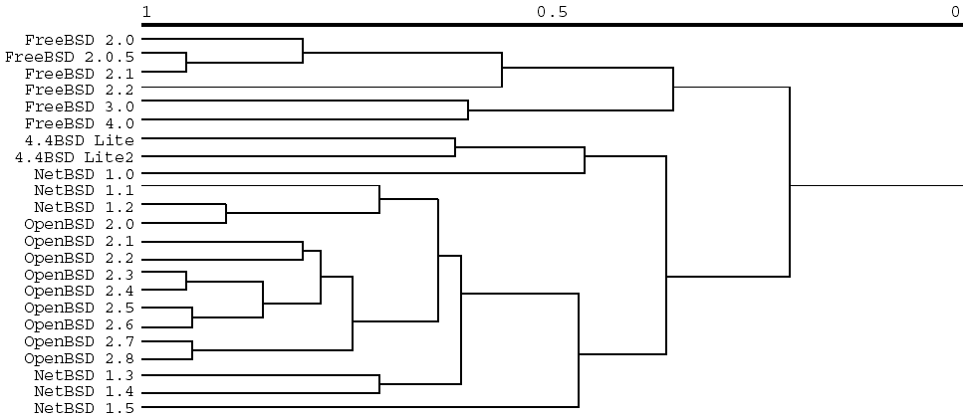
Analysis Technology (1-2)
System similarity analysis based on code clone detection
History of BSD OS by System Similarity Using Clone

Slide 40

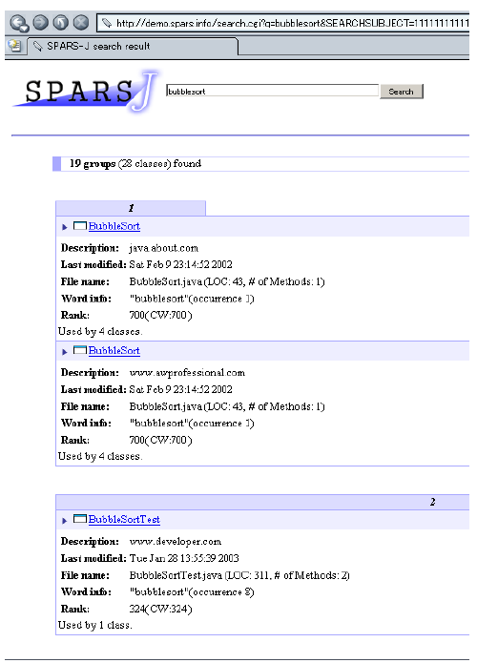

Analysis Technology (2)
SPARS ~ Software Asset Search Engine
Searching Result
for Bubblesort
Internet or
Organization’s
Repositories
Software Component
Searcher

Slide 41
Analysis Technology (3)
Collaborative Filtering
Robust estimation method with missing data
Applicable to estimating various attributes of project/system from similar project/system profiles
Focused
Represen-
tative
Q & M
Resources
Collaborative
Outcome
Adopted
9
9
9
7
7.5
(target)
App. A
8
7
8
?
(missing)
8
App. B
?
(missing)
8
8
8
7
App. C
7
6
?
(missing)
9
6
App. D
Notes:
One of the advantage of CF is its robustness to the defective data.
In the procedure for evaluating similarities, for each part of applications, we can use all factors with data in the pair of applications.
Defective data decrease the accuracy of estimation or prediction, but does not make the problem critical.

Slide 42
Analysis Technology (4)
Complication analysis by logical coupling
Logical Coupling
  A logical relationship between software modules where changes in a part of one module require changes in a part of another module.
By knowing logical coupling, the cause of a module’s complexity becomes clear, providing hints about module structure and where restructuring may be needed.
File
Bug correction and
function change
Change relation
simultaneously
Notes:
Fix

Slide 43
Analysis Technology (5)
GQM Paradigm (example: Project delay risk detection model)
Analyze CVS and GNATS data for file change patterns, for the purpose of evaluation, with respect to requirements instability, poor design, or poor product quality, from the point of view of the project manager, in the context of the particular project in the company
Goal
Question
File change level (FCM)?
The number of developers making changes to files (ONR)?
The number of lines changed (LCC)?
The reason for the change?
Change frequency of each file (CVS)
Size of file (CVS)
Number of developers making changes to files (CVS)
The changed number of lines in each file (CVS)
Change motive: Bug or specification change (GNATS)
Metric

Slide 44
Collaboration between EASE and SEC
The Ministry of Education, Culture, Sports, Science and Technology
Information-technology Promotion Agency, JAPAN
Consortium for Software
Engineering
Development of data collection system (EPM)
Development of traffic information platform
Automated data collection system for use in industry
Software engineering technique
Development support
7 major automotive and IT companies
EASE project
Software Engineering Center
1000 project data
Industrial development data
Analysis result
Execution of proof experiments
Analysis of data
Analysis of data
(Data collection and analysis result feedback)

Slide 45
Applying EPM in Industries
EPM is being applied to several real projects
  Business systems (Hitachi GP, Ltd.)
  Personal mobile applications (Mitsubishi Space Software Co., Ltd.)
  Automobile information systems (SEC collaborative project)…
Very low additional effort by developers for data collection
Collected data is currently under analysis
  Many findings only from collected data such as
    Module refactoring candidates
    Internal trouble detection

Slide 46
EPM application experience
Collaborating Enterprises | Hitachi GP, Ltd. | Mitsubishi Space Software Co., Ltd.
Software for application | Package software for business in municipality agency | Software purchased by a certain enterprise
Development language | Java | Java, others
Development period | 6 months | 10 months
Development scale | 130,000 Loc | 250,000 Loc
EPM introduction and operation cost | 25 man-days | 11 man-days
EPM subjective evaluation by developers | The automated data collection is useful. The presentation method of the analysis result is a useful means to see software and the development process objectively. | The data collection doesn't disturb the development. The project transitions can be objectively understood from the collected data.

Slide 47
EPM application organization (in 2005)
Applied or being applied
Soon to be applied
Hitachi Government &
Public Corporation System
Engineering, Ltd.
Software engineering center
Consortium for Software
Engineering
Toyota Motor Corporation
DENSO CORPORATION
NEC Corporation
Hitachi, Ltd.
Fujitsu Limited
Matsushita Electric
Industrial Co., Ltd.
NTT DATA Corporation
Sumisho Computer
Systems Corporation
Hitachi Systems &
Services, Ltd.
JFE Systems, lnc.
Yokogawa Electric Corporation
Kochi University of Technology
HANNAN UNIVERSITY
OSAKA UNIVERSITY
NARA INSTITUTE of
SCIENCE and TECHNOLOGY
MITSUBISHI SPACE
SOFTWARE CO,, LTD.

Slide 48
Making of EPM open source
Japanese version in June
  Downloaded about 300 so far
English version is available from today.
License
  Empirical Project Monitor License (EPML) that fixed the special contract articles to Common Public License (CPL) was made.
  The user selects either CPL or EPML.
ＣＰＬ
License regulations of U.S. IBM made based on IBM Public License. When software that combines the source code of CPL with the source code of original development is made, and the object code is distributed, it has to open only the part of the source code of CPL to the public.
EPML: Special contract of articles
The modification code need not be opened to the public, and be delivered to the project member the distribution ahead when the change to EPM and the source code (modification code) in an additional part are distributed or the individual who made the modification code distributes the modification code that hangs to the main employment corporation or individual moreover by the joint research project etc. to develop software by using EPM.
・・・

Slide 49
Lessons Learned in EASE
The data collection cost is very low compared with the development cost.
  It reached 10-20% of the development cost so far.
Data analysis costs must be reduced.
  As application experience increases, more systematic reuse of the analysis work process is expected.
Clarification of concrete needs for analysis.
  Example: "Analysis at the program module level and management of unexpected values are necessary."
Grasp of the situation and detection of abnormalities can be done using only collected data and analysis results.
  Even inexperienced students identified significant points and understood the software construction process more clearly using EPM data and analysis.

Slide 50
Summary

Slide 51
Summary
This talk was about
  The current status of the software industry in Japan
  The SEC (Japan Software Engineering Center)
  Empirical software engineering
  The EASE project (Empirical Approach to Software Engineering)
  and EPM (Empirical Project Monitor)
People don’t like a document-based approach. (Phillip Johnson Dec. ’99, Empirical software engineering.)
→automated data collection system: EPM
EPM: Simple is best.

Slide 52
Thank you for your attention.
Please try the EPM open source software from
  http://www.empirical.jp/English/

